Slide 1
Connectomics of Neurodegeneration
Spread of α-synuclein pathology through the brain connectome is modulated by selective vulnerability and predicted by network analysis Henderson, M.X. et al. Nat. Neurosci.
Presented by: Tyler Short
Notes:
University of Pennsylvania

Slide 2
Spread of α-synuclein pathology through the brain connectome is modulated by selective vulnerability and predicted by network analysis
Intro to Topics
α-synuclein:
Helps deliver neurotransmitters
α-synuclein pathology:
Parkinson’s Disease (PD), Dementia with Lewy Bodies (LBD)
Connectome:
How the brain is connected
Predicted by network analysis:
Computationally/mathematically modeled

Slide 3
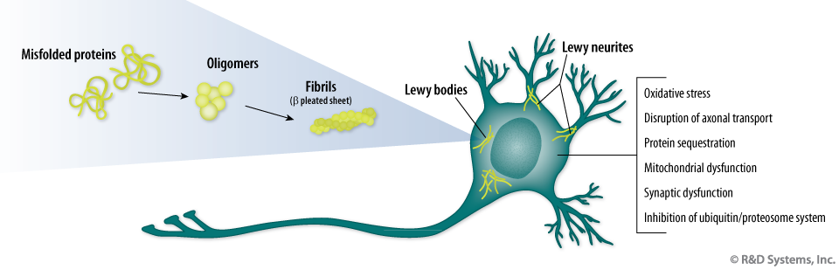
Background
Parkinson’s Disease & LBD
Like dementia, caused by accumulation of misfolded proteins
Fibrils form Lewy Bodies
Lewy bodies cause cell dysfunction & death
Dopaminergic neurons in PD

Slide 4
Purpose
There is no cure for neurodegenerative disease. Current treatment strategies focus primarily on managing symptoms: active immunization or injection of monoclonal antibodies that target α-syn can decrease pathogenic α-syn spread, and slow disease progression in mice. The first immunotherapies that target α-syn have passed stage I clinical trials in humans.
Predictive models of protein spreading can guide new therapeutic approaches, for example, by promoting protein clearance, blocking protein aggregation, or by modulating intercellular spreading.

Slide 5
Purpose
What are the underlying mechanisms of protein pathogenesis?
Is spreading driven by extracellular diffusion or intracellular transport?
Do misfolded proteins propagate retrogradely or anterogradely?
How do protein expression levels modulate pathogenesis?

Slide 6
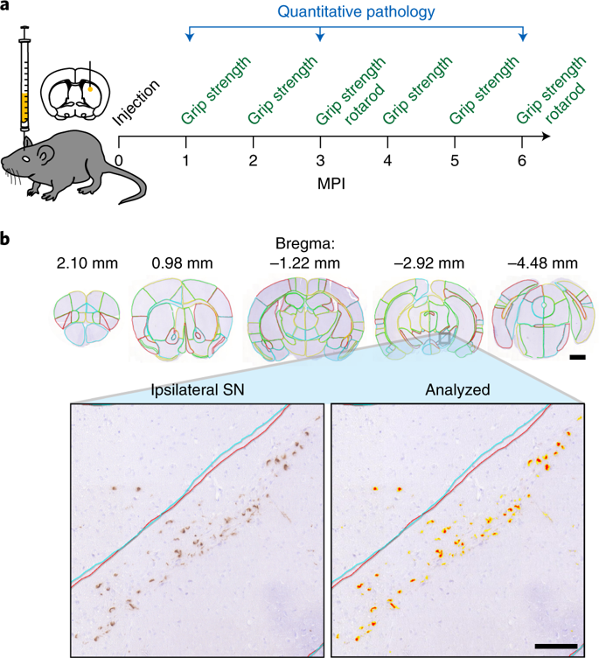
Experiment
Inject mice with α-synuclein pre-formed fibrils (PFFs)
Test grip strength
Allow mice to age 1, 3 or 6 months post-injection (MPI)

Slide 7
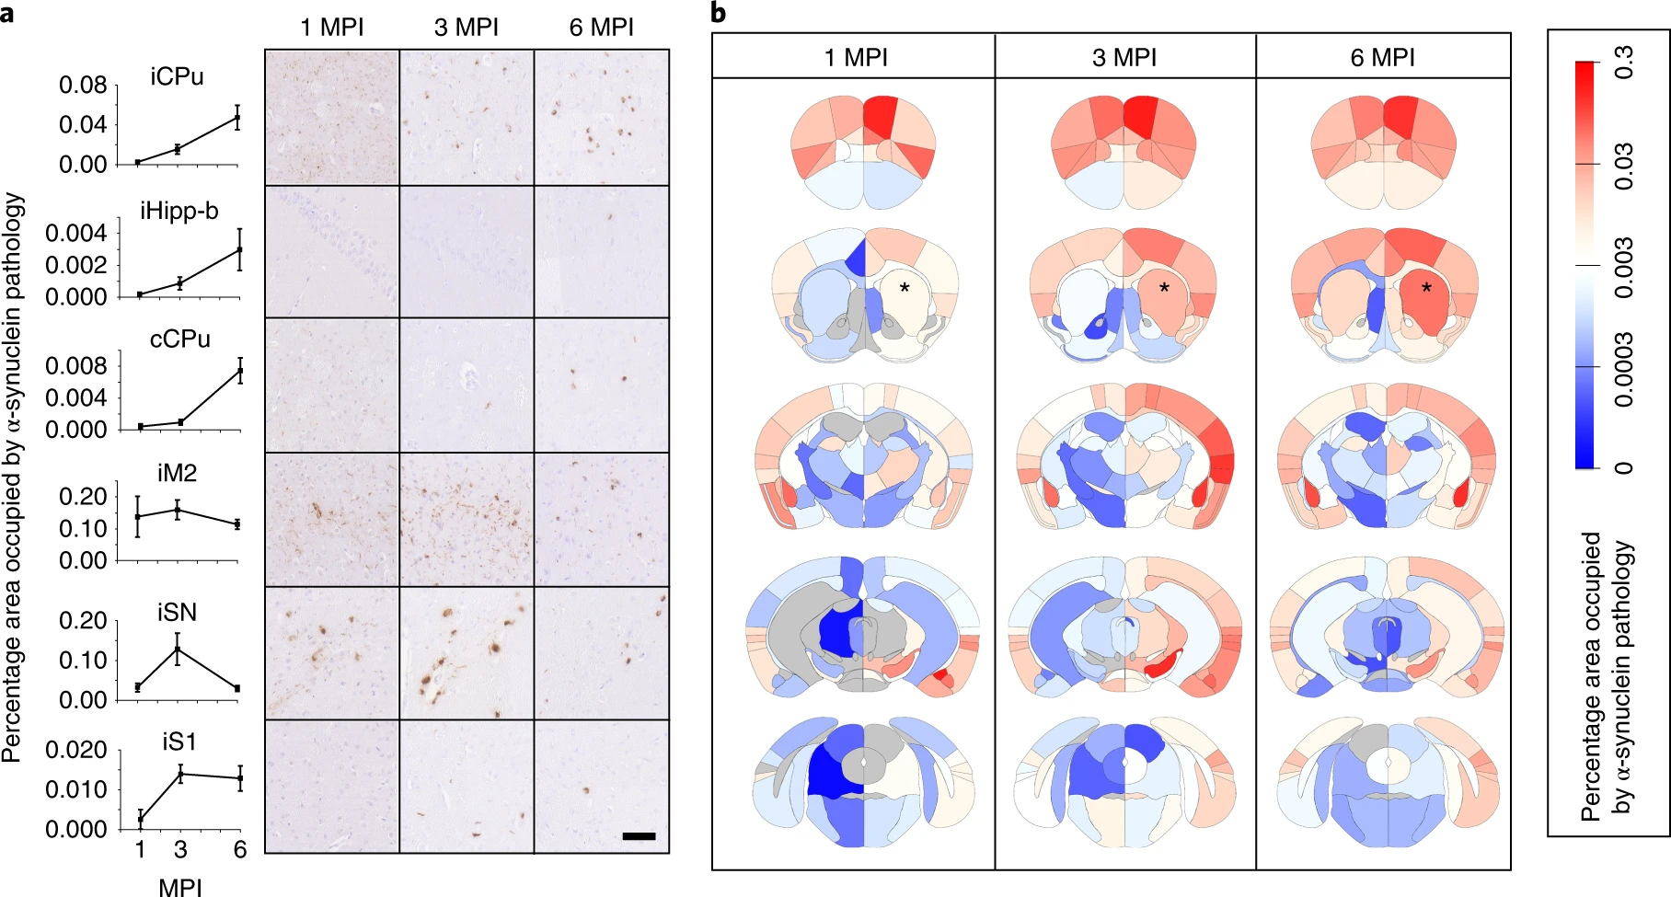
Tracking the Progression
Brains were sectioned and stained for pathological misfolded and phosphorylated α-synuclein.
ipsilateral caudoputamen (iCPu),
Ipsilateral hippocampus (iHipp-b),
contralateral Cpu (cCPu),
ipsilateral secondary motor cortex (iM2),
ipsilateral substantia nigra (iSN),
ipsilateral primary somatosensory cortex (iS1))

Slide 8
Tracking the Progression
* = Injection site → Caudoputamen
Each brain region displays distinct spreading profiles and a characteristic timeline of progression.
Regions with a direct anatomical connection to the injection site display higher degrees of pathology than remotely connected regions.

Slide 9
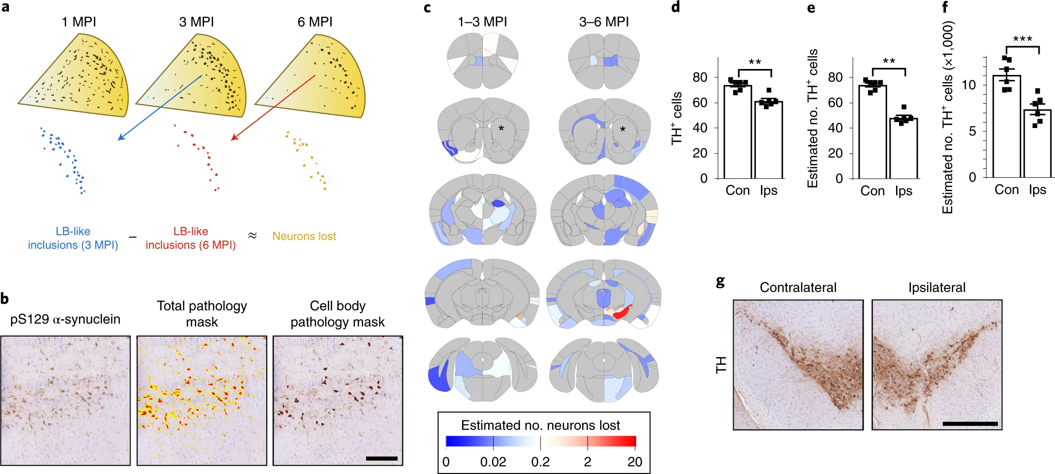
Tracking the Damage
Previous work demonstrated loss of cell body pathology is indicative of the death of the inclusion-bearing neurons.
Estimates of neuron loss in each region was made by measuring cell body inclusion levels throughout the brain and using the difference between time points as an estimate of neuron loss
SN

Slide 10
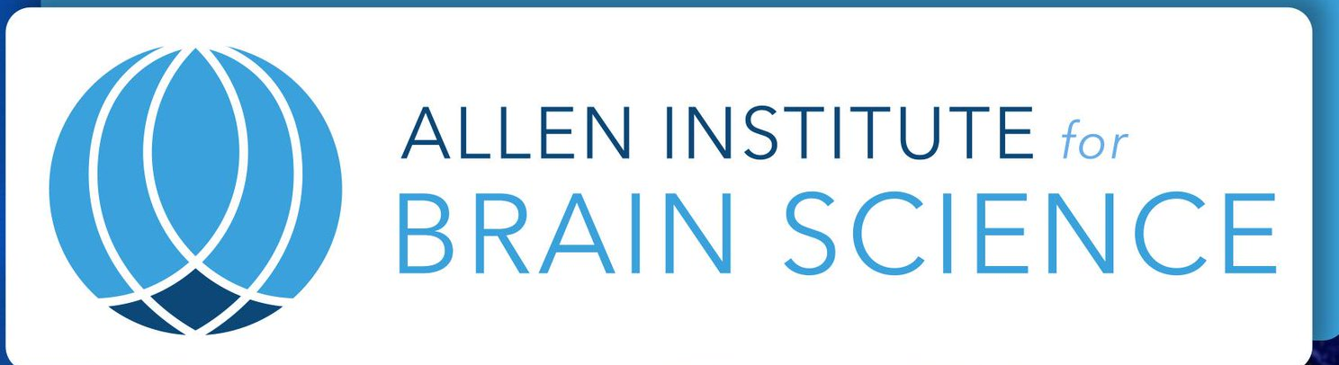
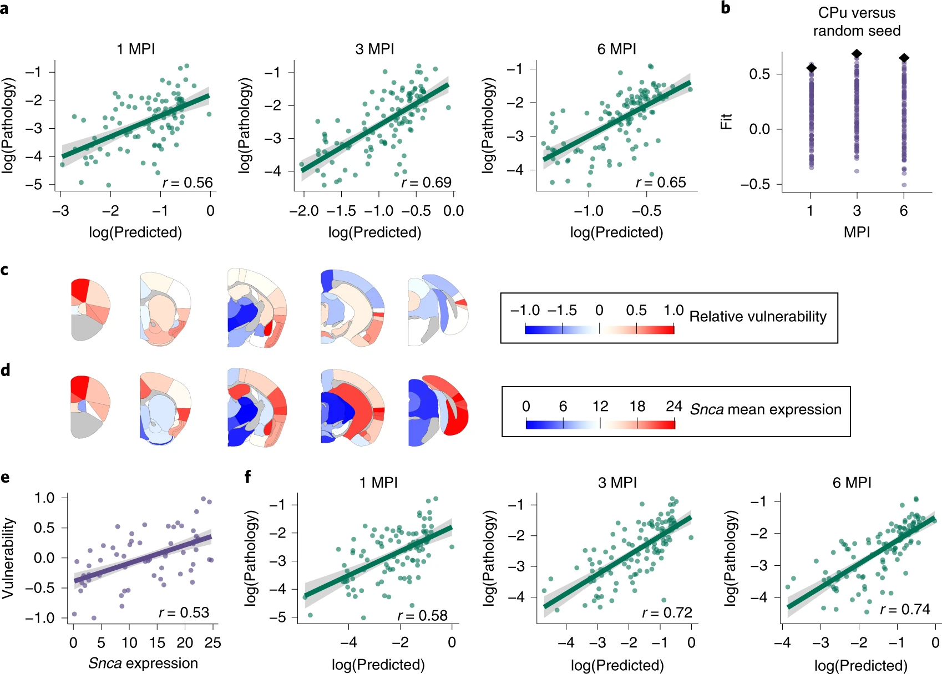
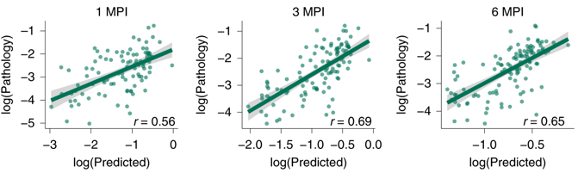
Modeling Pathological α-syn Spread
Data from the Allen Brain Atlas for mice was used to predict spread of α-syn.
That was then compared to the collected results.

Slide 11
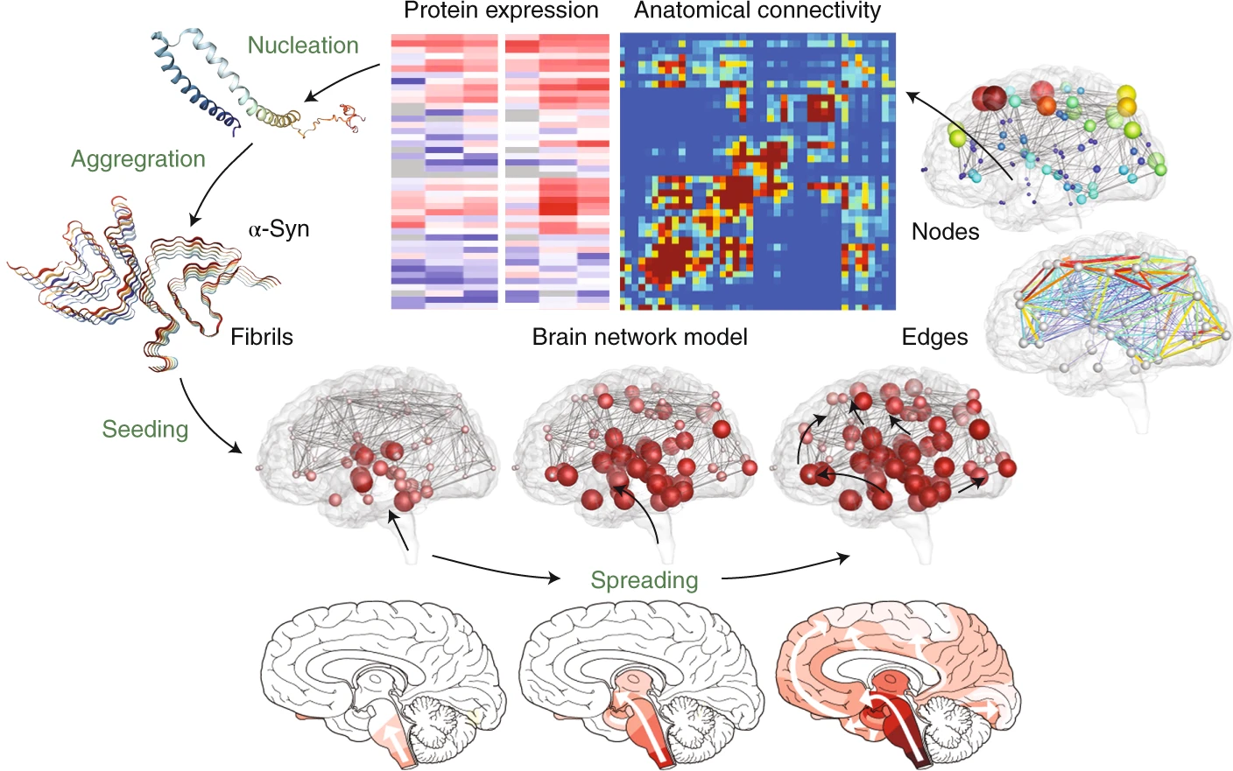
Modeling Pathological α-syn Spread
Authors hypothesized that one factor that should influence the development of α-syn pathology is α-syn expression.
Snca expression from the Allen Brain Atlas was used to compound the connectivity model.

Slide 12
Modeling Pathological α-syn Spread
The connections of every node was weighted by its respective Snca expression.
Indeed, incorporation of Snca expression into the model improved the ability of the model to accurately predict the burden of α-synuclein pathology

Slide 13
Implications & Discussion
What are the underlying mechanisms of protein pathogenesis?
Still not entirely understood
Is spreading driven by extracellular diffusion or intracellular transport?
A diffusion model showed more accurate predictions
Do misfolded proteins propagate retrogradely or anterogradely?
Predominantly retrogradely
How do protein expression levels modulate pathogenesis?
Highly correlated with connectivity and >expression = >pathology

Slide 14
Implications & Discussion
These results are an important step toward quantitative, predictive brain network modeling in Parkinson’s disease.
Properly calibrated and validated, such models are powerful tools to quickly elaborate what-if scenarios and answer fundamental questions of pathological spread

Slide 15
Implications & Discussion
In view of the fast developments in neuroimaging and the rapid growth of public databases like the Human Connectome Project or the Alzheimer’s Disease Neuroimaging Initiative, it seems reasonable to expect that we will soon have access to longitudinal human disease data to validate network diffusion models for neurodegeneration in humans.

Slide 16
Implications & Discussion
The most innovative aspect of this study is that it establishes, calibrates and validates a new technology, protein-expression-weighted brain network modeling, to understand, explain and predict pathological protein spreading in neurodegenerative disease

Slide 17
Questions and Comments?
Thank you!

